Slide 1
Snakes & Ladders:
A Gentle Intro to Generators & Iterators
JR Rickerson

Slide 2

Introduction
JR Rickerson
Software Craftsman @ Red Rivet Studios
Notes:
Introduction:
Good morning!
My name is JR Rickerson
I’ve been a freelancer and developer since 2010
Company is Red Rivet Studios
Also a training instructor

Slide 3
Goals
Understand two powerful features of Python
Ubiquitous, but often misunderstood
Use a simple game to help us understand
Notes:
Goals
Understand two powerful features of Python
Features are ubiquitous but often misunderstood
We’ll use a simple game to help us understand, and have a little fun

Slide 4

DISCLAIMER
THIS TALK CONTAINS NO AI / LLMs
https://tenor.com/view/hackers-wood-shop-class-taogifs-cereal-killer-gif-1075670516990179895
Notes:
DISCLAIMER
This talk contains no references to AI or LLMs, and no AI-generated images.
If you accidentally came to the wrong class please see your counselor.

Slide 5
The Game

Slide 6
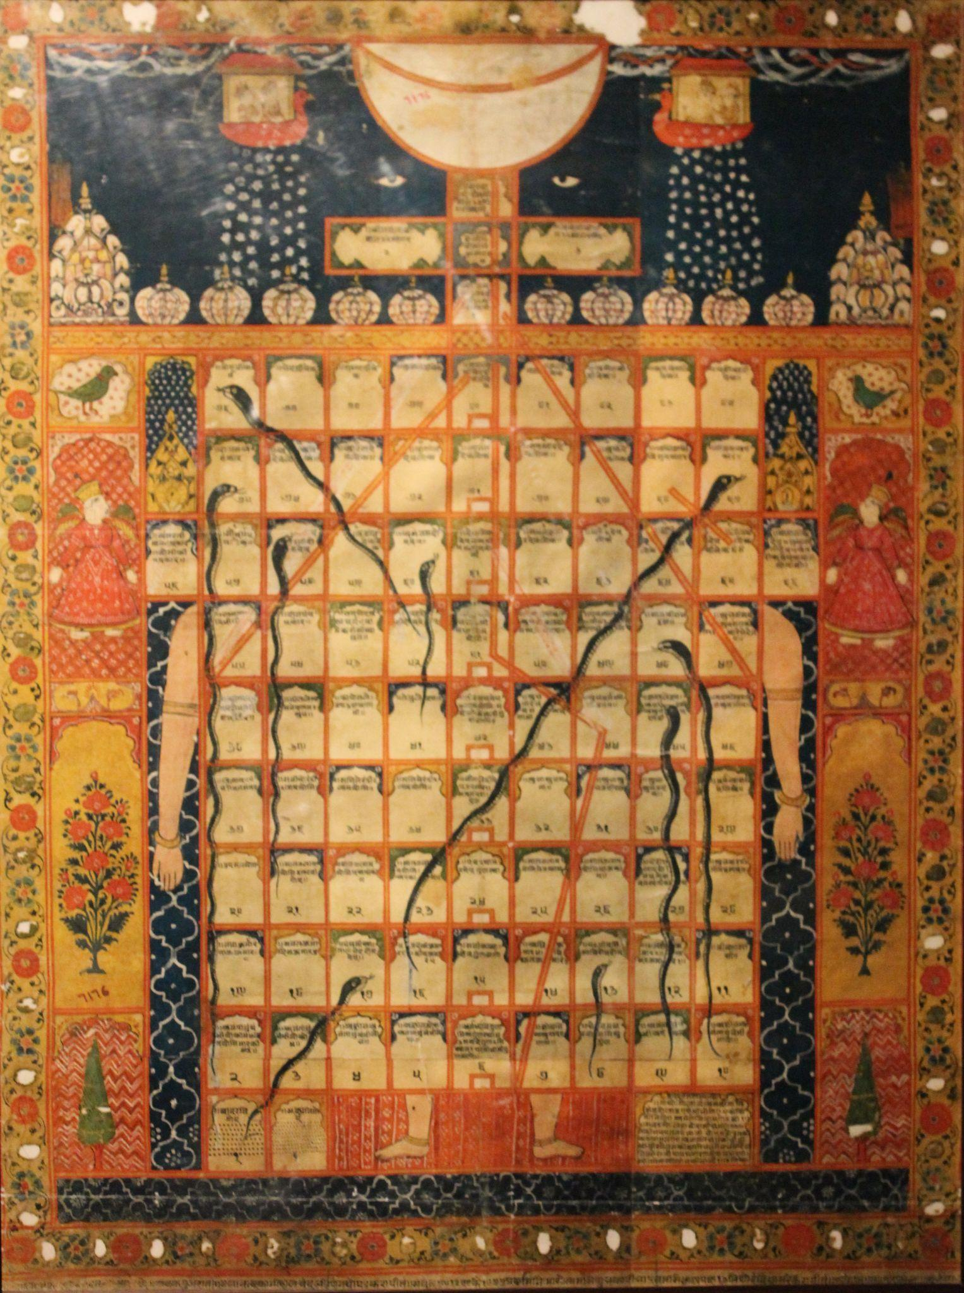
Snakes & Ladders: Origins
From a 2nd century game in India called Gyan chaupar
Adapted in Victorian England as “Snakes and Ladders”
Teach children moral lessons
https://en.wikipedia.org/wiki/Snakes_and_ladders#/media/File:Gyan_chaupar.JPG
Notes:
S&L Origins:
Dates to 2nd century game in India call GEYAN CHO-PAR
Brought to Victorian England and adapted as Snakes and Ladders
Teach children moral lessons

Slide 7
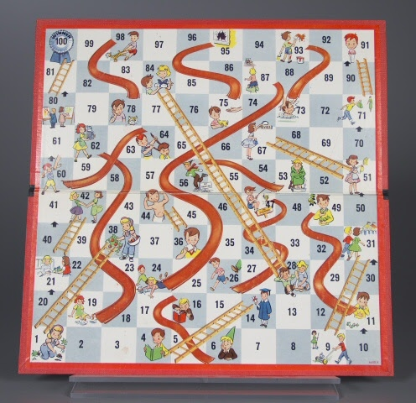
Snakes & Ladders: Origins
Popularized in the US as Chutes & Ladders by Milton Bradley (1943)
Kept the morality theme
Notes:
S&L Origins:
Most popular version of the game was adapted by Milton Bradley in 1943 as “Chutes and Ladders”
Kept the same morality theme
Note the actions and consequences - #4 reading leads to #14 graduation, #98 pulling the cat’s tail leads to #78 scratches

Slide 8
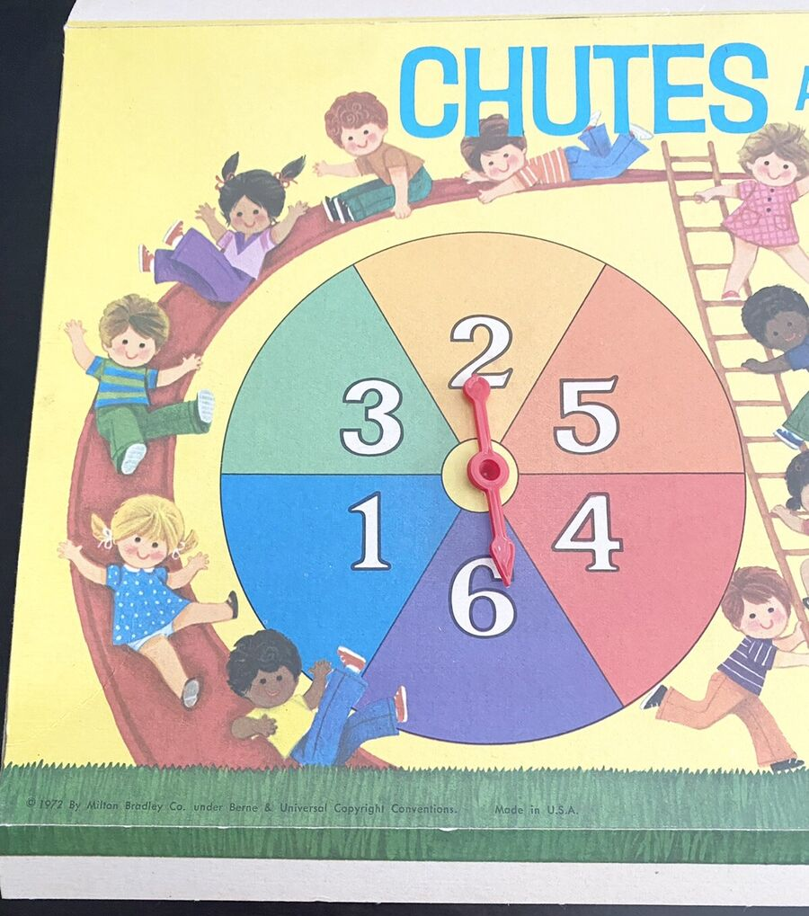
Snakes & Ladders: Gameplay
Played on a 10 x 10 grid
Players roll dice or use a spinner
Ladders move you up, Snakes slide you down
No strategy, just luck
Notes:
S&L: Gameplay
Played on a 10x10 grid, first to space 100 wins
Roll dice or use a spinner to see how far you move
Ladders move you up several spaces
Snakes can slide you back down several spaces
No strategy - just luck of the dice

Slide 9
The Ladders:
Iterators

Slide 10
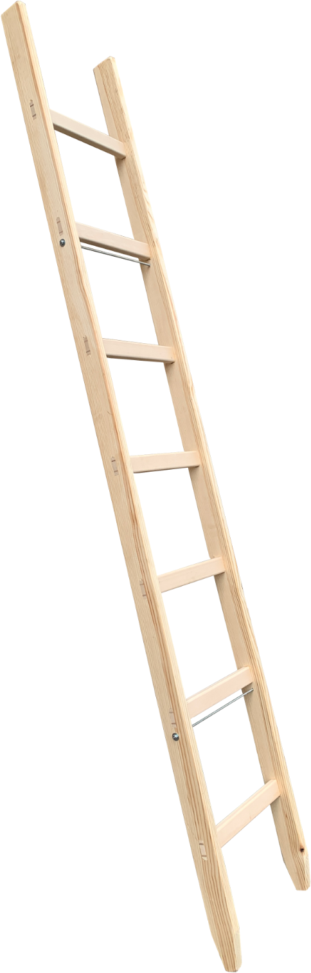
Python Iterators
Added in Python 2.1 - PEP 234 (2001)
Python “Protocol”
Get an object you can call next() on
Notes:
Python Iterators
Added in Python 2.1, in PEP 234, circa 2001
An example of a Python Protocol - something that can be implemented by many types
Allows us to request an object that we can call next() on repeatedly, usually get to items from a sequence

Slide 11
Iterators: For Loops
games = ["checkers", "chess", "shogi", "backgammon"]
# Get an iterator, move through the list
for game in games:
print(f"{game} has a long legacy.")
Notes:
Iterators: For Loops
You’ve probably used iterators without even realizing it
Python for loops are one of the main ways Python uses iterators
The for loop requests an iterator from the list, then calls next on that iterator repeatedly to get each item
The loop ends when the iterator raises StopIteration
Works with builtins - lists, dictionaries, tuples, sets, and more

Slide 12
Iterators: Files
with open("ladders.txt") as file:
for line in file:
print(f"Move up the ladder on space {line}")
1
4
9
21
28
36
51
Notes:
Iterators: Files
Iterators can also be requested from file objects after you open them
The iterator produces one item for each line of the file as a string (for text files)
Works the same way for other content - XML parsers, Database rows (DBAPI), web pages (requests library)

Slide 13
Iterator “Magic” methods
Built-in iter() function - ask for a new iterator
Types implement __iter__ for iterator support (Iterables)
This is how all the built-in sequences work!
Notes:
Iterator Magic Method
We don’t normally need to call these ourselves
For loops and other things that use iterators call these for us
These magic methods are how Python works behind the scenes
We can build our own types that do exactly the same things!

Slide 14
Iterator “Magic” methods
Built-in next() function - get the next item
Types implement __next__ if they can be iterated
Iterators raise StopIteration exception to end
Notes:
Iterator Magic Methods:
Once an iterator has been returned by the “iter()” function, we want the items from it
Builtin function next() gives us those items
When it runs out of items, like the end of the list, next() raises StopIteration
For loops, etc. suppress that exception, but it lets them know when to exit the loop.

Slide 15
The “Magic” of Magic methods
I don’t have to know or care anything about how the sequence stores or retrieves its data - I can just ask for an Iterator and use it to grab items one by one.
I JUST have to know how to deal with each item!

Slide 16
Making Our Own Iterable Class
Step 1: Start with a plain old Python class
Step 2: Implement __iter__

Slide 17
Making Our Own Iterable Class
Step 3: Implement __next__

Slide 18
The Snakes:
Generators

Slide 19

Python Generators
Added in Python 2.2 - PEP 255 (2002)
Introduced the new yield keyword
Generators ARE Iterators, but with extra magic
https://www.spectatornews.com/opinion/2022/12/dont-become-an-ouroboros/#
Notes:
Python Generators:
Added in Python 2.2
Introduced “yield” keyword
Generators ARE iterators

Slide 20
Why Use Generators?
Lists, Dicts, etc. must load EVERY item up front
Generators load one item at a time
Save time and memory if you don’t consume the whole sequence.
Can create infinite sequences.
Notes:
Why Use Generators:
Lists, Dicts, etc. must load all data up front
Generators can load (generate) one item at a time
Saves time and memory if you don’t use the whole sequence
Can create infinite sequences

Slide 21
How Generators Work
Like normal functions, but they can “resume”
Generator functions “remember” their context
Notes:
How Generators Work
Look like normal functions
Must contain a “yield” statement
Generators remember their context

Slide 22
Generator Functions
def generate_pieces():
print("Starting the generator!")
yield "pawn"
yield "rook"
yield "knight"
yield "bishop"
yield "queen"
yield "king"
print("Ended the generator!")

Slide 23
Enhanced Generators
Added in Python 2.5 - PEP 342 (2005)
Enhances Generators with the send() method
Allows generators to resume from a different value

Slide 24
Making Our Own Generators: Generator Function
def list_func():
return ["A", "K", "Q", "J", "10", "9", "8", "7", "6", "5", "4", "3", "2"]
def gen_func():
yield "A"
yield "K"
yield "Q"
yield "J"
yield "10"
yield "9"
yield "8"
yield "7"
yield "6"
yield "5"
yield "4"
yield "3"
yield "2"

Slide 25
Making Our Own Generators: Classes
Start with a plain old Python class
Implement __iter__
Implementation should yield values

Slide 26
Making Our Own Generators: Classes
class Deck:
suits = ["Hearts", "Spades", "Clubs", "Diamonds"]
values = ["A", "K", "Q", "J", "10", "9", "8", "7", "6", "5", "4", "3", "2"]
def __iter__(self):
for suit in self.suits:
for val in self.values:
yield f"{val} of {suit}"
# No need for __next__()

Slide 27
Building Snakes & Ladders

Slide 28
Building Player Turns
Classic Approach: Use a while loop and if statements
Generator Approach: Use an infinite generator

Slide 29
Building Dice Roles
Classic Approach: Function to return random value
Generator Approach: Generator to return dice rolls

Slide 30
Building The Board
Classic Approach: Pre-create the entire board up front; 1 global board
Generator Approach: Only create the next value required, separate boards per player

Slide 31
Questions?
JR Rickerson
Red Rivet Studios, Inc.
https://linkedin.com/in/jrrickerson

